Slide 1


Academic and Curricular Advising Management System ACAMS
SCHOOL OF
ENGINEERING
Alejandro, Rosemarie
Gecale, Matthew
Manongsong, Shella
Marinda, Hamill

Slide 2
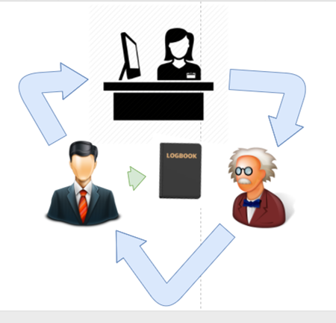
Problem | Case 1
Problem
Proposed Solution
Objectives
Module Access Level
Functions:
Log in
Account Recovery
Create a Case
Case Management
Add Notes
See all notes
Close Case
Show all Cases
Import to Database
Generate Report
Self Registration

Slide 3
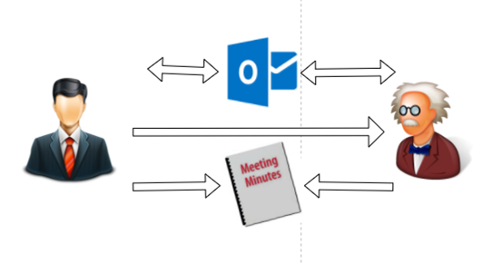
Problem | Case 2
Problem
Proposed Solution
Objectives
Module Access Level
Functions:
Log in
Account Recovery
Create a Case
Case Management
Add Notes
See all notes
Close Case
Show all Cases
Import to Database
Generate Report
Self Registration

Slide 4


Proposed Solution
Problem
Proposed Solution
Objectives
Module Access Level
Functions:
Log in
Account Recovery
Create a Case
Case Management
Add Notes
See all notes
Close Case
Show all Cases
Import to Database
Generate Report
Self Registration
1 MEETING = 1 CASE
Case ID # : ___________ Date Created: _____
Nature: ___________
Category: ___________
Sub- Category : _______
Date Closed: _____
DATE / TIME / USER ID
DATE / TIME USER ID
Student
Faculty

Slide 5


Proposed Solution
Problem
Proposed Solution
Objectives
Module Access Level
Functions:
Log in
Account Recovery
Create a Case
Case Management
Add Notes
See all notes
Close Case
Show all Cases
Import to Database
Generate Report
Self Registration
CASE 1
CASE 2
CASE 3
CASE 4
Request
Report
View
Report

Slide 6


Proposed Solution
Problem
Proposed Solution
Objectives
Module Access Level
Functions:
Log in
Account Recovery
Create a Case
Case Management
Add Notes
See all notes
Close Case
Show all Cases
Import to Database
Generate Report
Self Registration
A
B
A
B

Slide 7


Proposed Solution
Problem
Proposed Solution
Objectives
Module Access Level
Functions:
Log in
Account Recovery
Create a Case
Case Management
Add Notes
See all notes
Close Case
Show all Cases
Import to Database
Generate Report
Self Registration
Adviser A
Adviser B

Slide 8


Proposed Solution
Problem
Proposed Solution
Objectives
Module Access Level
Functions:
Log in
Account Recovery
Create a Case
Case Management
Add Notes
See all notes
Close Case
Show all Cases
Import to Database
Generate Report
Self Registration
LOCATION 1
Faculty
LOCATION 2
Case 1
Case 2
Case 3
LOCATION 3

Slide 9


Proposed Solution
Problem
Proposed Solution
Objectives
Module Access Level
Functions:
Log in
Account Recovery
Create a Case
Case Management
Add Notes
See all notes
Close Case
Show all Cases
Import to Database
Generate Report
Self Registration
CASE 1
Current Subject
Past Subject

Slide 10
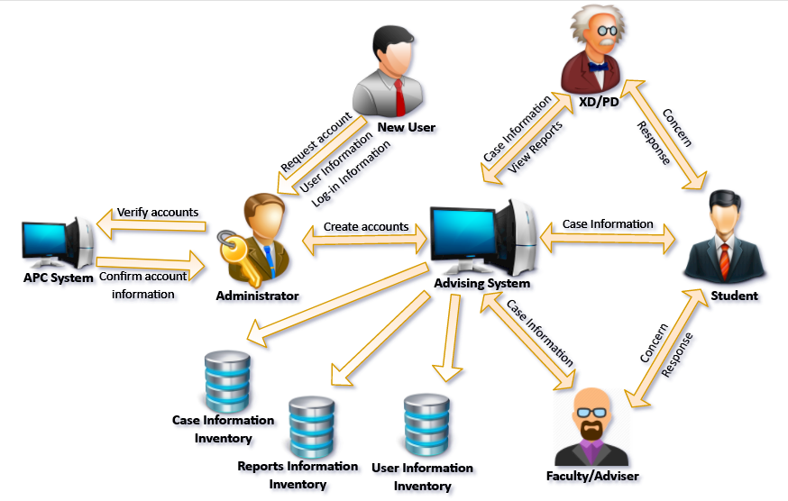
Proposed Solution
Problem
Proposed Solution
Objectives
Module Access Level
Functions:
Log in
Account Recovery
Create a Case
Case Management
Add Notes
See all notes
Close Case
Show all Cases
Import to Database
Generate Report
Self Registration

Slide 11
Objectives | General Objective
Problem
Proposed Solution
Objectives
Module Access Level
Functions:
Log in
Account Recovery
Create a Case
Case Management
Add Notes
See all notes
Close Case
Show all Cases
Import to Database
Generate Report
Self Registration
To develop and design a web-based intranet system for Asia Pacific College – School of Engineering that will serve as a medium of communication for student and faculty and to centralize students’ academic and curricular advising records.

Slide 12
Objectives | Specific Objective
Problem
Proposed Solution
Objectives
Module Access Level
Functions:
Log in
Account Recovery
Create a Case
Case Management
Add Notes
See all notes
Close Case
Show all Cases
Import to Database
Generate Report
Self Registration
Develop:
Registration
Log in
Case
Reports

Slide 13

Module Access Level
Problem
Proposed Solution
Objectives
Module Access Level
Functions:
Log in
Account Recovery
Create a Case
Case Management
Add Notes
See all notes
Close Case
Show all Cases
Import to Database
Generate Report
Self Registration
USER ROLE | LOGIN | REGISTRATION | CASE | REPORTS | IMPORT
Executive Director
Program Director
Adviser
Faculty
Student

Slide 14
Log in | Objective
Problem
Proposed Solution
Objectives
Module Access Level
Functions:
Log in
Account Recovery
Create a Case
Case Management
Add Notes
See all notes
Close Case
Show all Cases
Import to Database
Generate Report
Self Registration
To be able to:
Familiarize with the log in page
Know how to log in

Slide 15
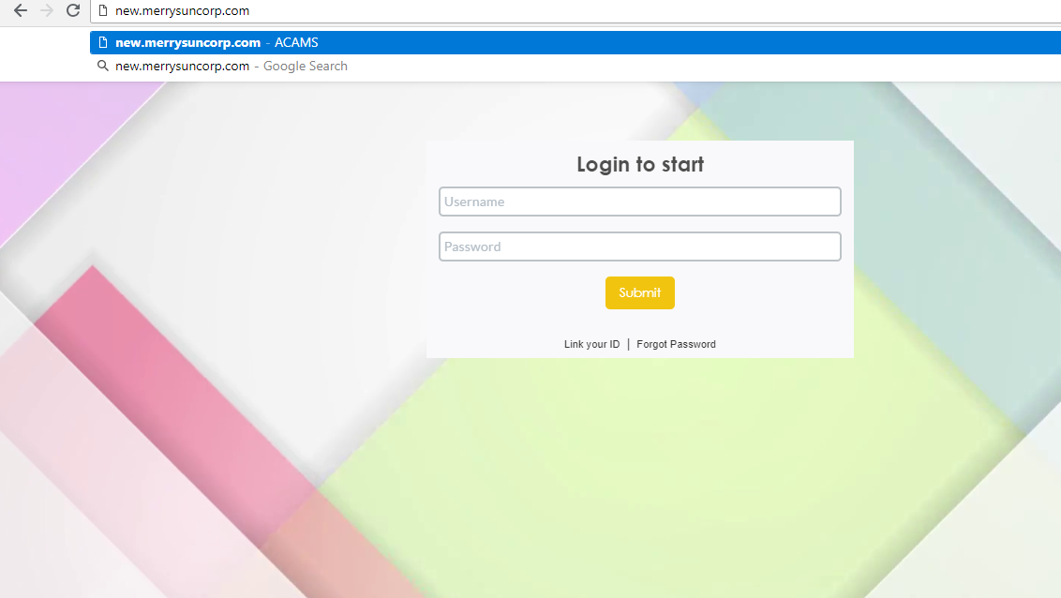
Log in | Demonstration
Problem
Proposed Solution
Objectives
Module Access Level
Functions:
Log in
Account Recovery
Create a Case
Case Management
Add Notes
See all notes
Close Case
Show all Cases
Import to Database
Generate Report
Self Registration
Link of ACAMS

Slide 16
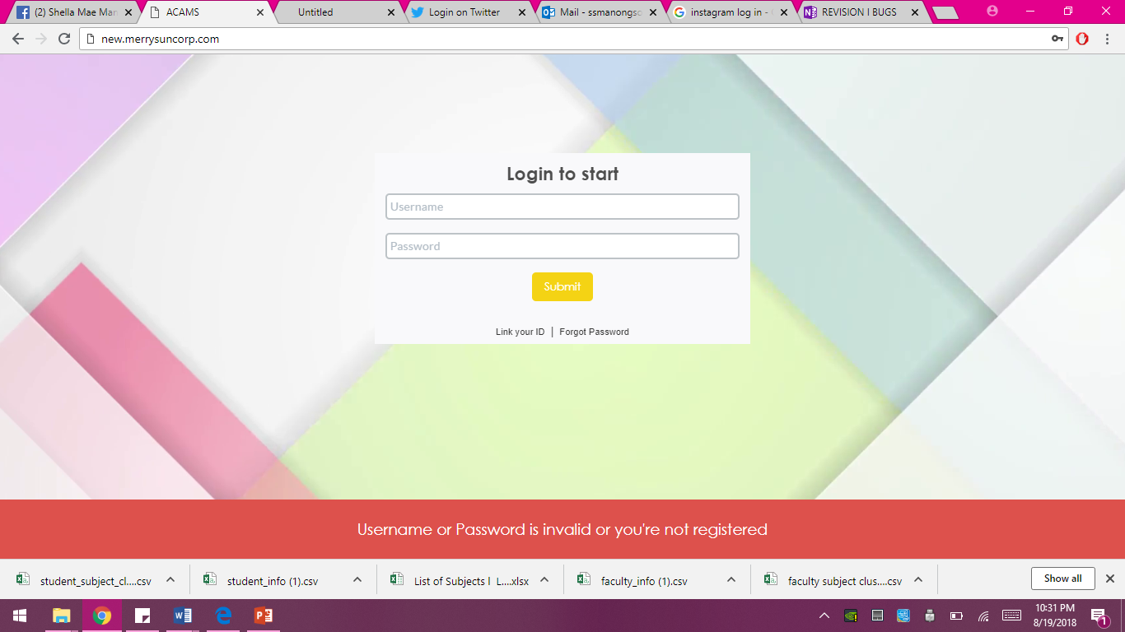
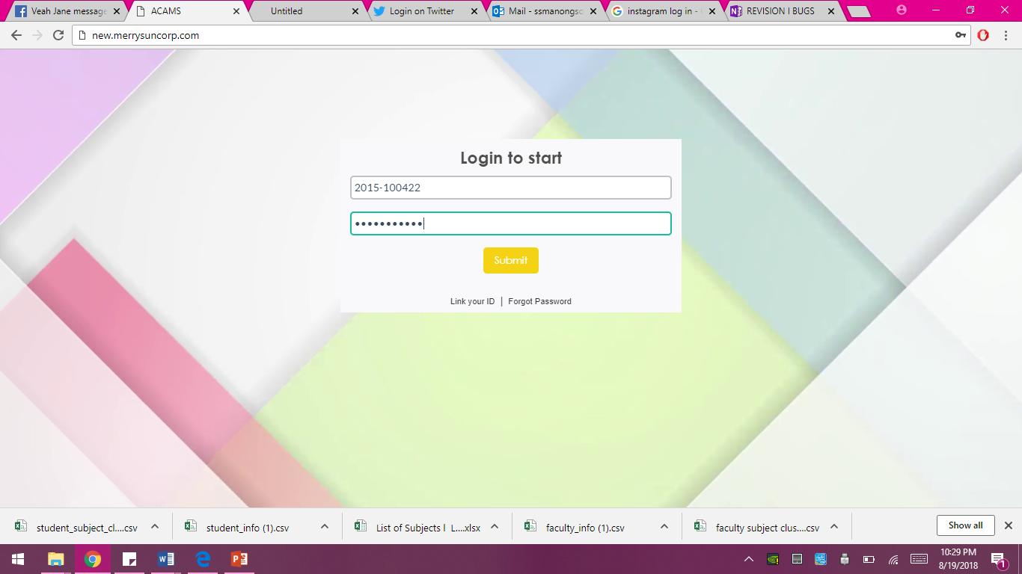
Log in | Demonstration
Problem
Proposed Solution
Objectives
Module Access Level
Functions:
Log in
Account Recovery
Create a Case
Case Management
Add Notes
See all notes
Close Case
Show all Cases
Import to Database
Generate Report
Self Registration
Click this button

Slide 17
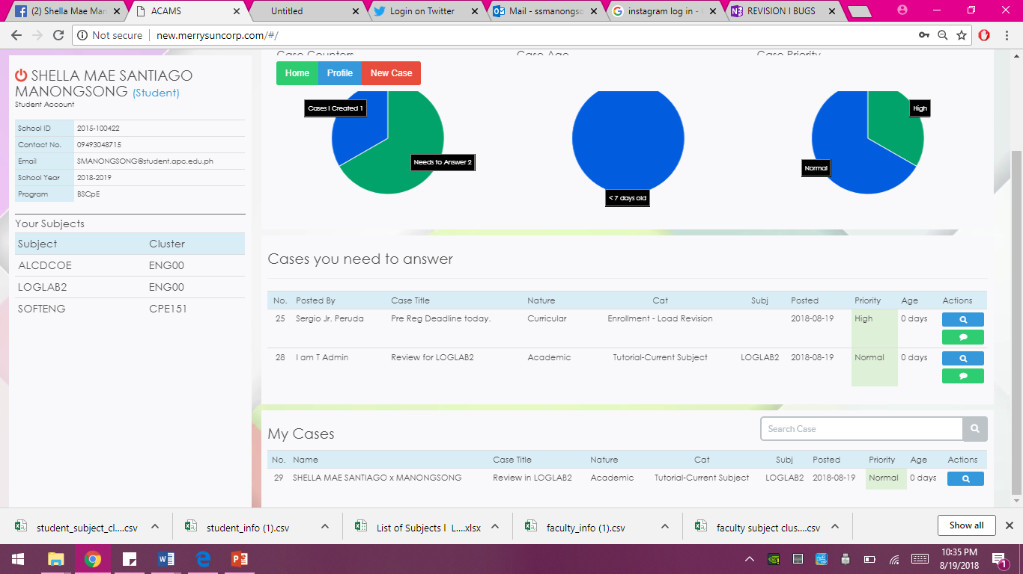
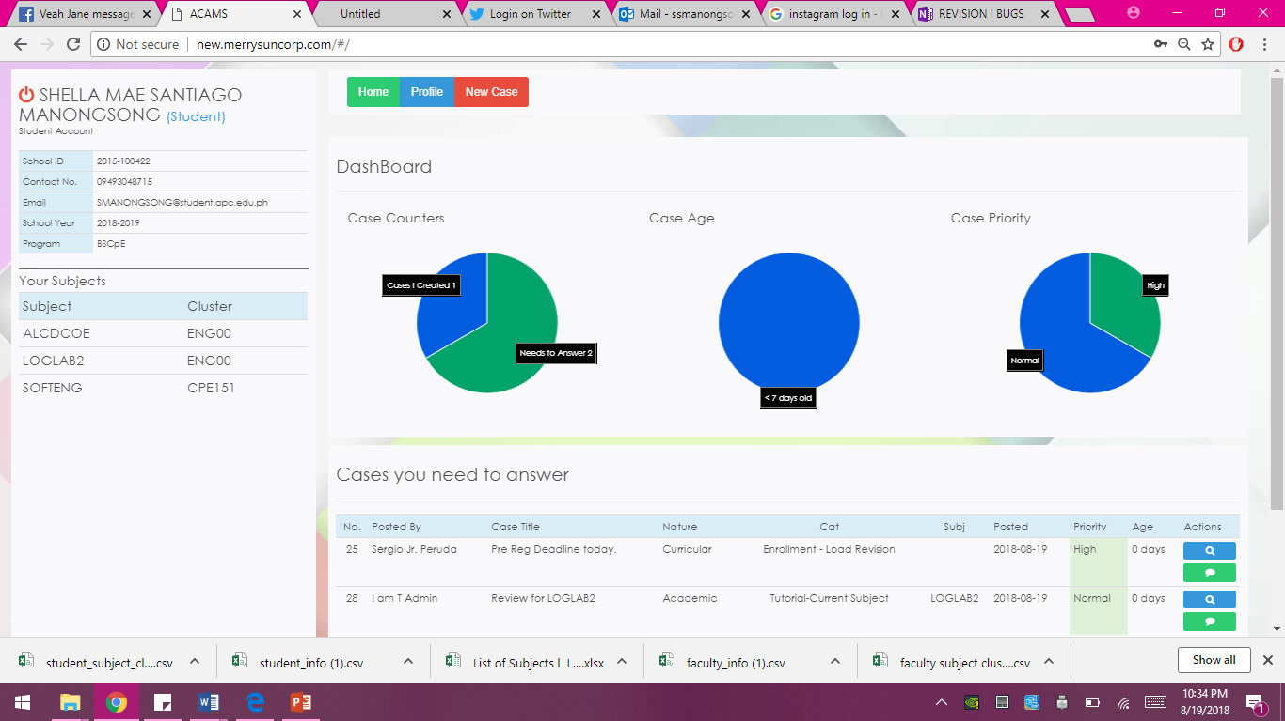
Log in | Demonstration
Problem
Proposed Solution
Objectives
Module Access Level
Functions:
Log in
Account Recovery
Create a Case
Case Management
Add Notes
See all notes
Close Case
Show all Cases
Import to Database
Generate Report
Self Registration
Click this button

Slide 18
Log in | Evaluation
Problem
Proposed Solution
Objectives
Module Access Level
Functions:
Log in
Account Recovery
Create a Case
Case Management
Add Notes
See all notes
Close Case
Show all Cases
Import to Database
Generate Report
Self Registration
Questions | Yes | No
Were you able to enter the school Id and password?
Does it redirect you to the homepage after you clicked the submit button?
Is there a message that notifies user if information inputted are incorrect or invalid?

Slide 19
Account Recovery | Objectives
Problem
Proposed Solution
Objectives
Module Access Level
Functions:
Log in
Account Recovery
Create a Case
Case Management
Add Notes
See all notes
Close Case
Show all Cases
Import to Database
Generate Report
Self Registration
To be able to:
Familiarize with account recovery page
Reset the password

Slide 20
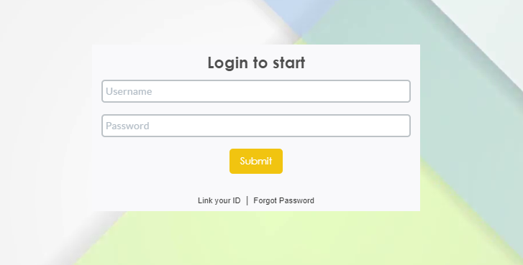
Account Recovery | Demonstration
Problem
Proposed Solution
Objectives
Module Access Level
Functions:
Log in
Account Recovery
Create a Case
Case Management
Add Notes
See all notes
Close Case
Show all Cases
Import to Database
Generate Report
Self Registration
Click this button

Slide 21
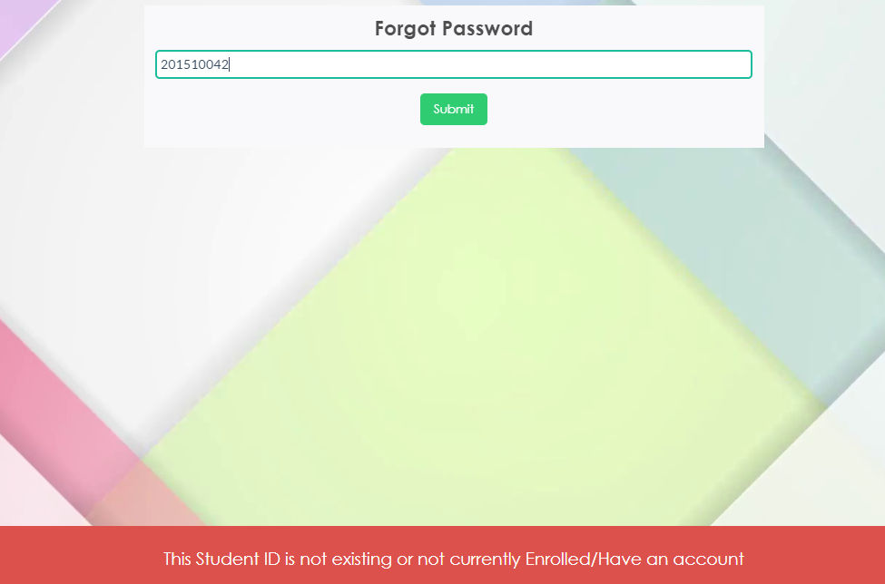
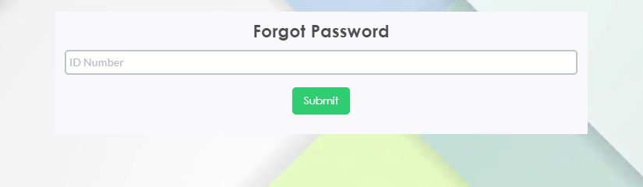
Account Recovery | Demonstration
Problem
Proposed Solution
Objectives
Module Access Level
Functions:
Log in
Account Recovery
Create a Case
Case Management
Add Notes
See all notes
Close Case
Show all Cases
Import to Database
Generate Report
Self Registration
Click this button
Enter ID Number

Slide 22
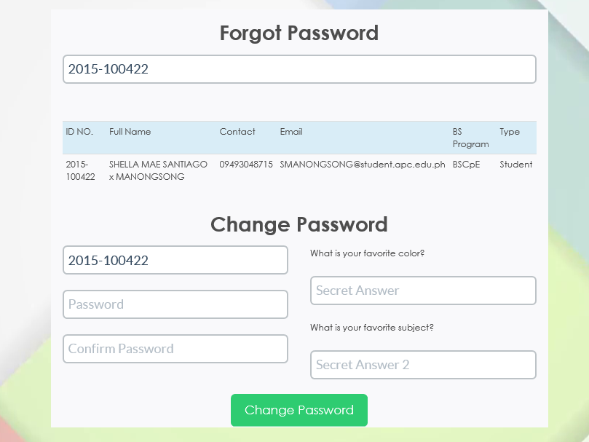
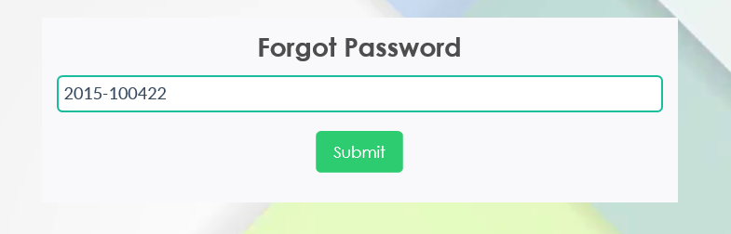
Account Recovery | Demonstration
Problem
Proposed Solution
Objectives
Module Access Level
Functions:
Log in
Account Recovery
Create a Case
Case Management
Add Notes
See all notes
Close Case
Show all Cases
Import to Database
Generate Report
Self Registration
Click this button
Enter new password
Answer your security questions
Confirm password

Slide 23
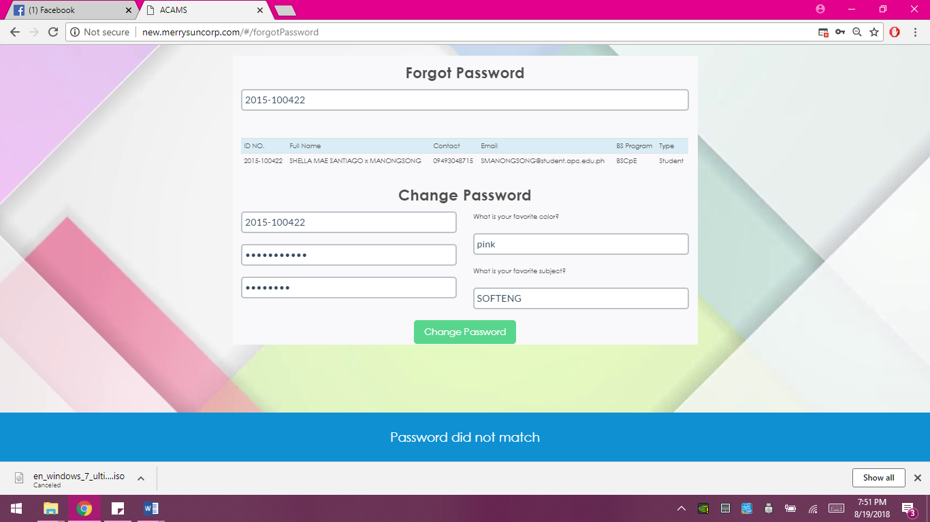
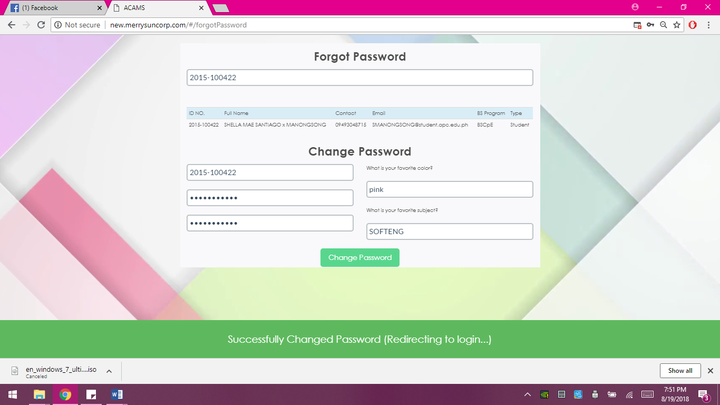
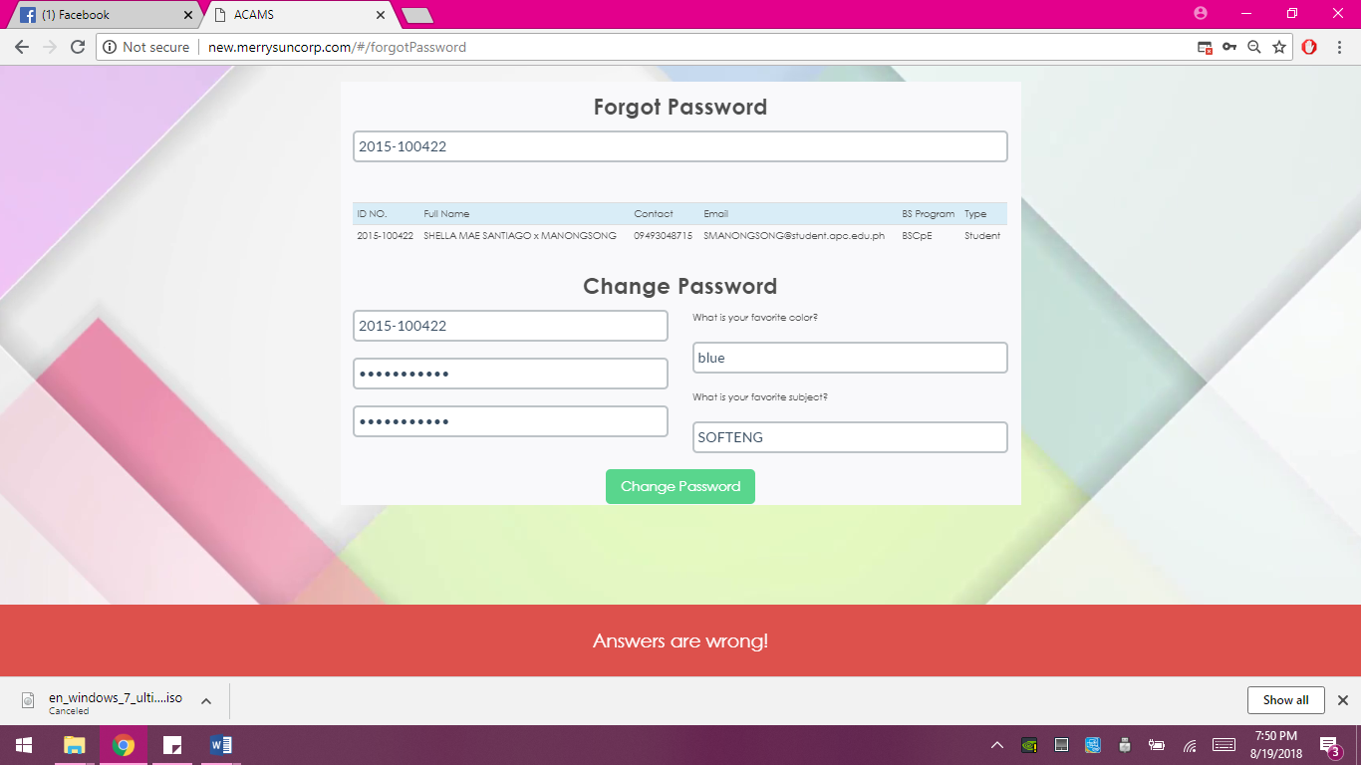
Account Recovery | Demonstration
Problem
Proposed Solution
Objectives
Module Access Level
Functions:
Log in
Account Recovery
Create a Case
Case Management
Add Notes
See all notes
Close Case
Show all Cases
Import to Database
Generate Report
Self Registration

Slide 24
Account Recovery | Demonstration
Problem
Proposed Solution
Objectives
Module Access Level
Functions:
Log in
Account Recovery
Create a Case
Case Management
Add Notes
See all notes
Close Case
Show all Cases
Import to Database
Generate Report
Self Registration
Click this button

Slide 25
Account Recovery | Evaluation
Problem
Proposed Solution
Objectives
Module Access Level
Functions:
Log in
Account Recovery
Create a Case
Case Management
Add Notes
See all notes
Close Case
Show all Cases
Import to Database
Generate Report
Self Registration
Questions | Yes | No
Were you able to enter the school ID?
Did it show the security questions your setup in the account?
Were you able to setup new password?
Is there a message that notifies user if information inputted are incorrect or invalid?
Is there a message that shows up to notify that the password change is successful?
Were you able to login using the updated password?

Slide 26
Create a Case | Objectives
Problem
Proposed Solution
Objectives
Module Access Level
Functions:
Log in
Account Recovery
Create a Case
Case Management
Add Notes
See all notes
Close Case
Show all Cases
Import to Database
Generate Report
Self Registration
To be able to:
Familiarize with the input fields (text boxes, dropdown boxes) in the Case page
View the case created

Slide 27
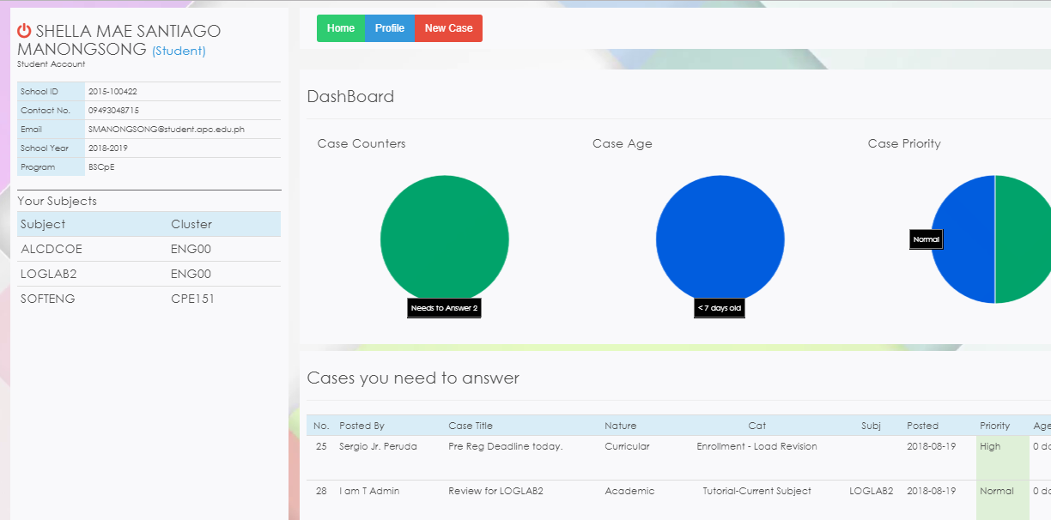
Create a Case | Demonstration
Problem
Proposed Solution
Objectives
Module Access Level
Functions:
Log in
Account Recovery
Create a Case
Case Management
Add Notes
See all notes
Close Case
Show all Cases
Import to Database
Generate Report
Self Registration
Click this button

Slide 28
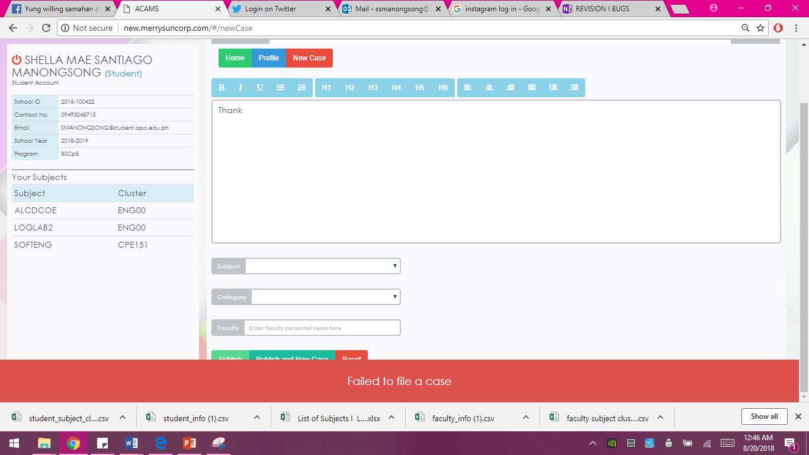
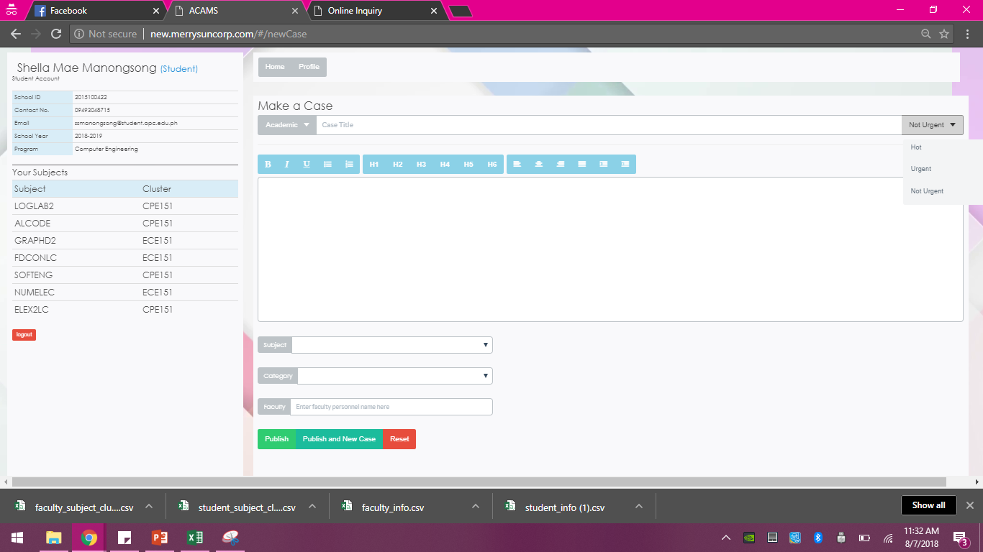
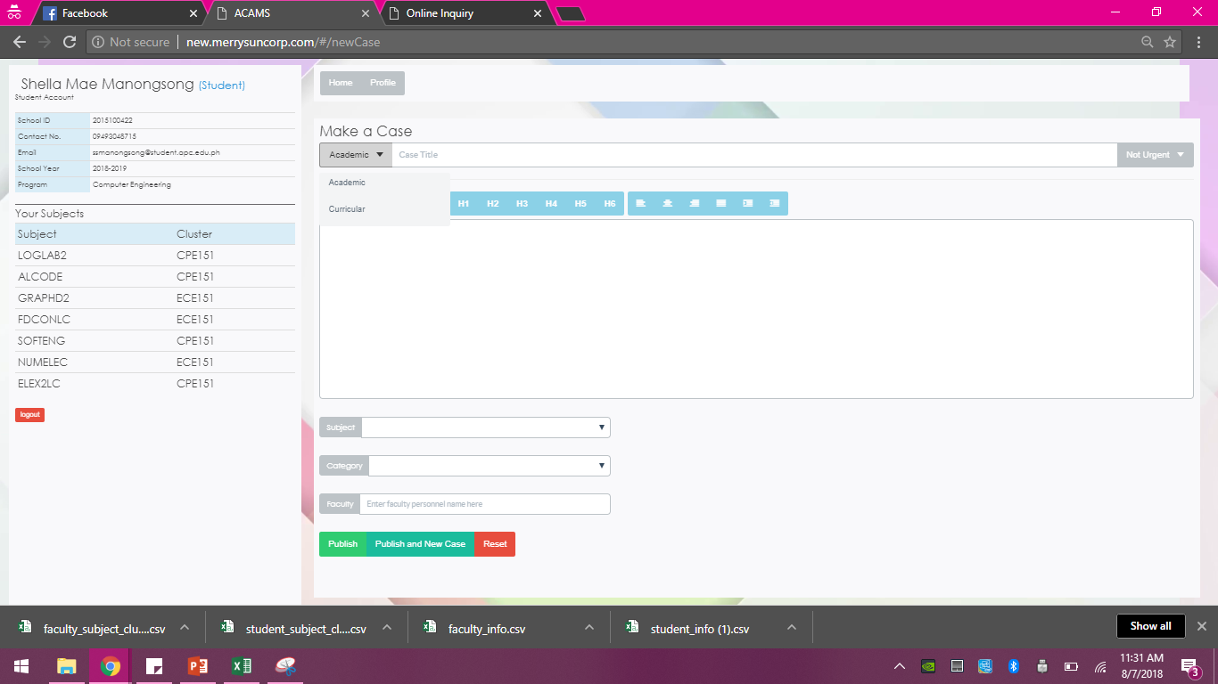
Create a Case | Demonstration
Problem
Proposed Solution
Objectives
Module Access Level
Functions:
Log in
Account Recovery
Create a Case
Case Management
Add Notes
See all notes
Close Case
Show all Cases
Import to Database
Generate Report
Self Registration
Click this dropdown box and select category
Click this drop down box and select the priority
Click this button

Slide 29
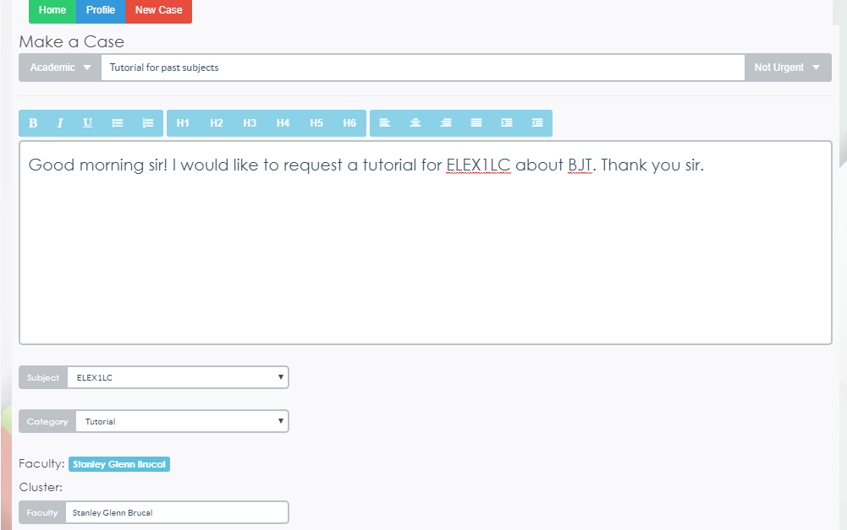
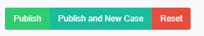
Create a Case | Demonstration
Problem
Proposed Solution
Objectives
Module Access Level
Functions:
Log in
Account Recovery
Create a Case
Case Management
Add Notes
See all notes
Close Case
Show all Cases
Import to Database
Generate Report
Self Registration
Select subject
Select category
Click this button

Slide 30
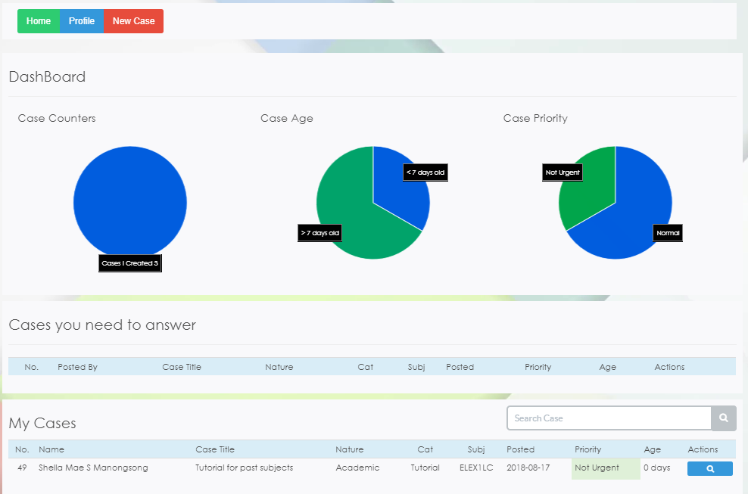
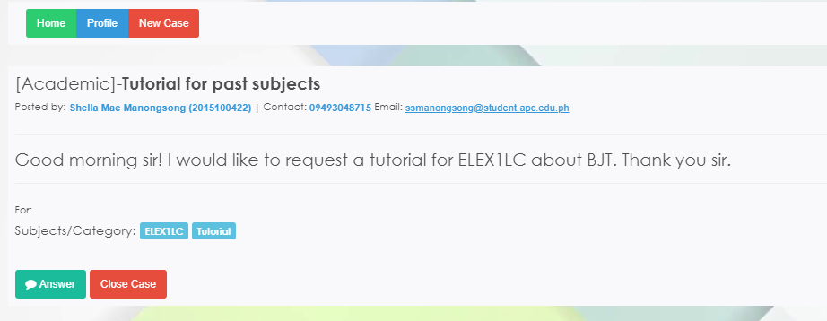
Create a Case | Demonstration
Problem
Proposed Solution
Objectives
Module Access Level
Functions:
Log in
Account Recovery
Create a Case
Case Management
Add Notes
See all notes
Close Case
Show all Cases
Import to Database
Generate Report
Self Registration
Click this button
My created case

Slide 31
Create a Case | Evaluation
Problem
Proposed Solution
Objectives
Module Access Level
Functions:
Log in
Account Recovery
Create a Case
Case Management
Add Notes
See all notes
Close Case
Show all Cases
Import to Database
Generate Report
Self Registration
Questions | Yes | No
When the “New Case” button is clicked, does it redirect you to a new case page?
Were you able to select the nature of the case?
Were you able to select the level of priority?
Were you able to select the category?
Were you able to set-up your own case title?
For cases academic in nature, were you able to select the subject that you are enrolled in?
Is the case directed to the correct recipient?
Is there a message that notifies user if information inputted is invalid?

Slide 32
Case Management | Objectives
Problem
Proposed Solution
Objectives
Module Access Level
Functions:
Log in
Account Recovery
Create a Case
Case Management
Add Notes
See all notes
Close Case
Show all Cases
Import to Database
Generate Report
Self Registration
To be able to:
Familiarize on how to view an existing case
Familiarize on how to add notes
Close a case

Slide 33
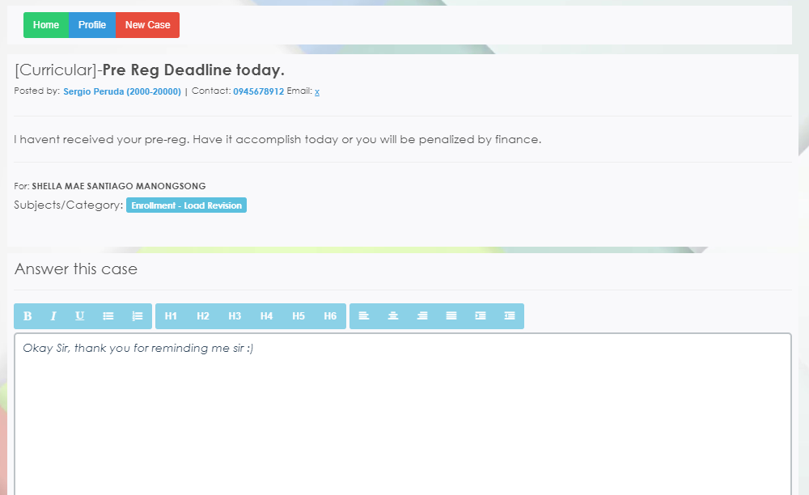
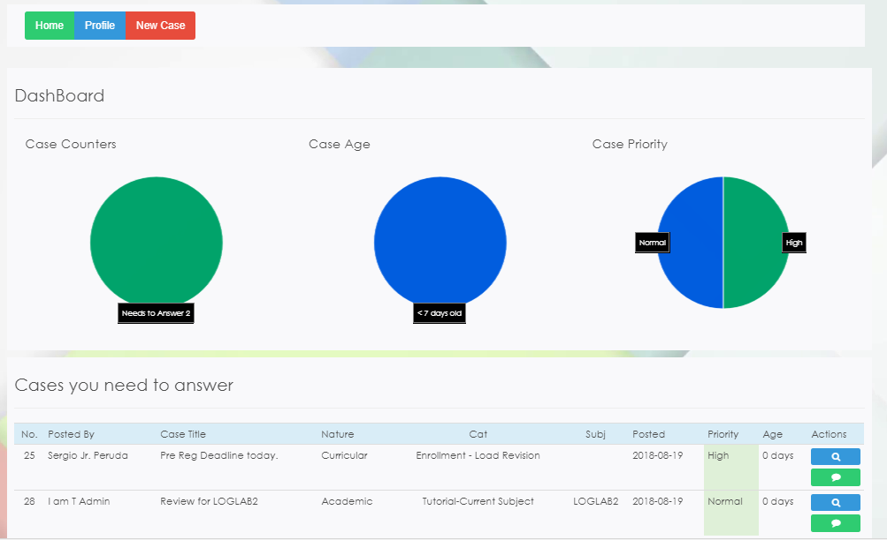
Add Notes | Demonstration
Problem
Proposed Solution
Objectives
Module Access Level
Functions:
Log in
Account Recovery
Create a Case
Case Management
Add Notes
See all notes
Close Case
Show all Cases
Import to Database
Generate Report
Self Registration
Click this button

Slide 34
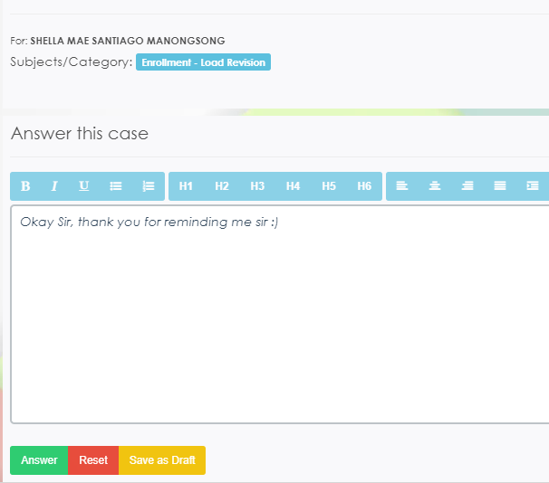
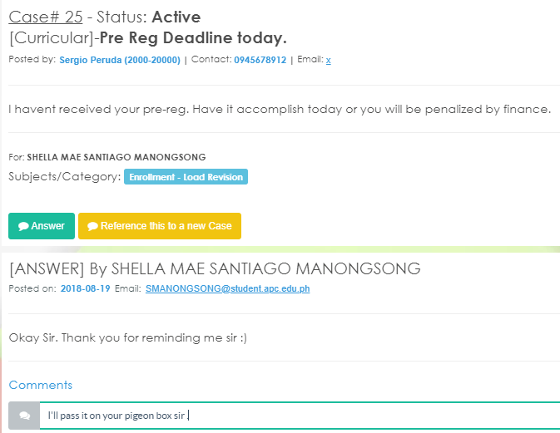
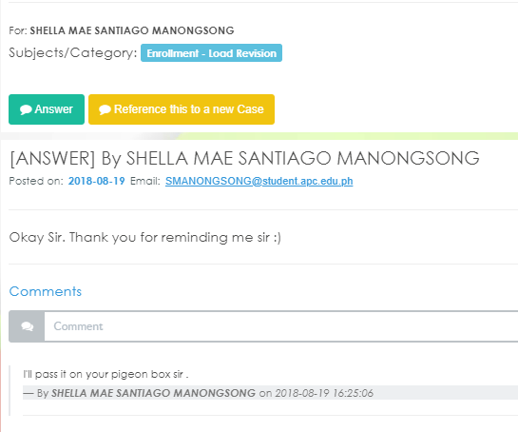
Add Notes | Demonstration
Problem
Proposed Solution
Objectives
Module Access Level
Functions:
Log in
Account Recovery
Create a Case
Case Management
Add Notes
See all notes
Close Case
Show all Cases
Import to Database
Generate Report
Self Registration
Click this button

Slide 35
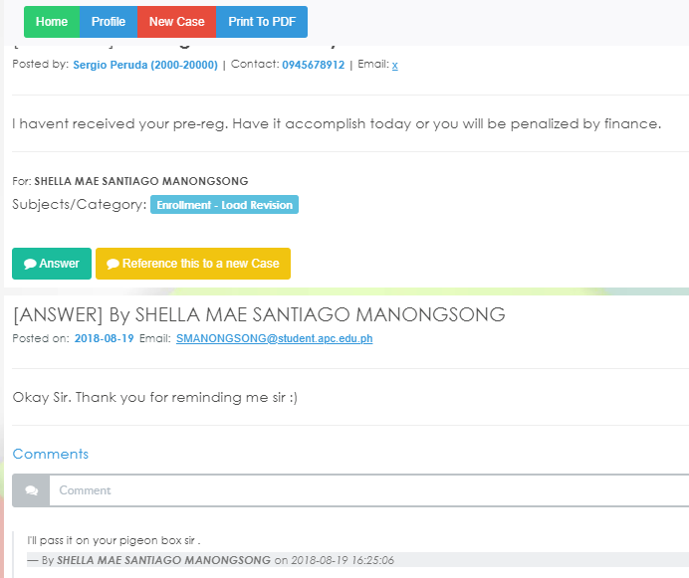
See all Notes | Demonstration
Problem
Proposed Solution
Objectives
Module Access Level
Functions:
Log in
Account Recovery
Create a Case
Case Management
Add Notes
See all notes
Close Case
Show all Cases
Import to Database
Generate Report
Self Registration
Click this button

Slide 36
Add Notes | Demonstration
Problem
Proposed Solution
Objectives
Module Access Level
Functions:
Log in
Account Recovery
Create a Case
Case Management
Add Notes
See all notes
Close Case
Show all Cases
Import to Database
Generate Report
Self Registration
Click this button

Slide 37
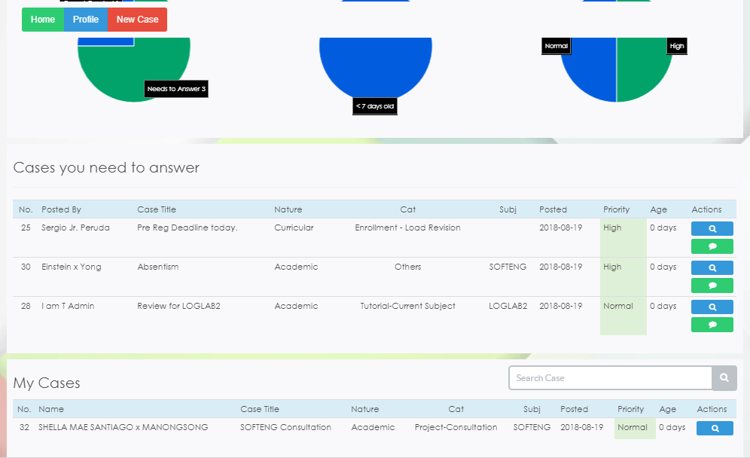
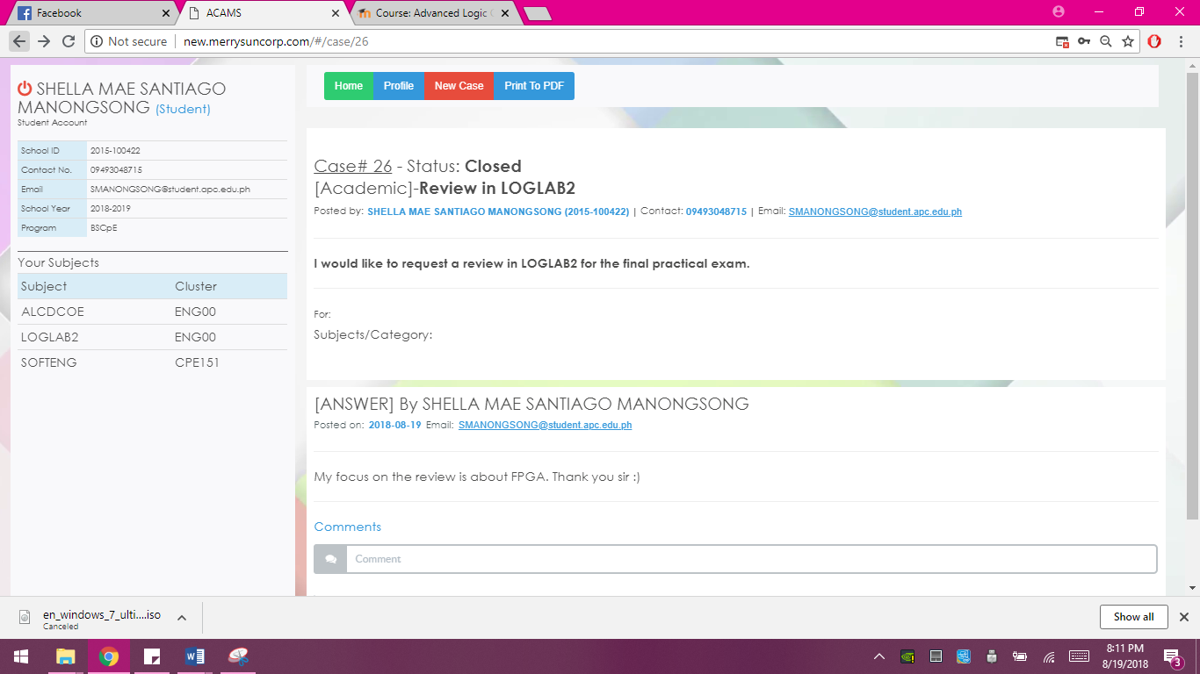
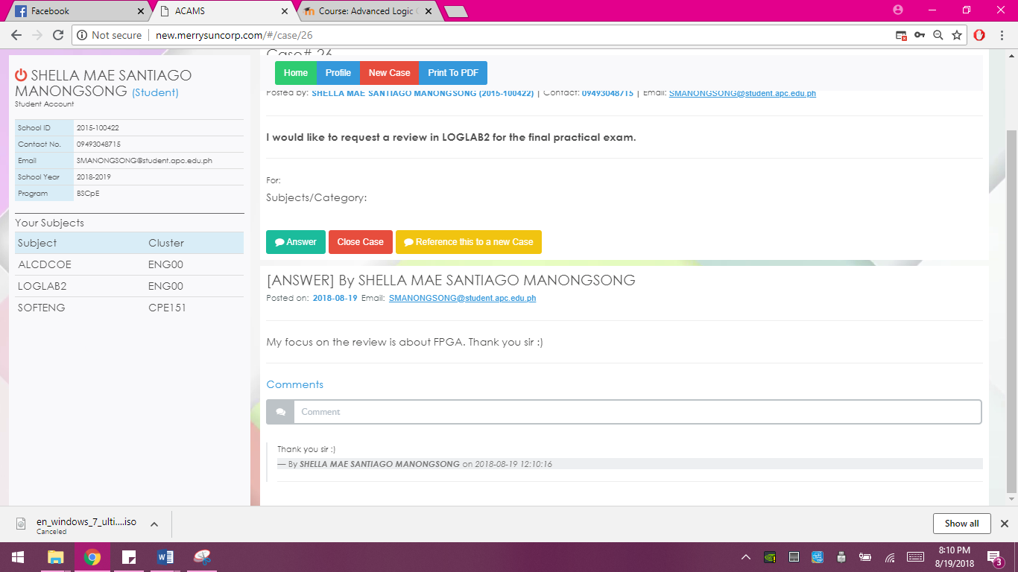
Close Case | Demonstration
Problem
Proposed Solution
Objectives
Module Access Level
Functions:
Log in
Account Recovery
Create a Case
Case Management
Add Notes
See all notes
Close Case
Show all Cases
Import to Database
Generate Report
Self Registration
Click this button
Click this button
Click this button

Slide 38
Case Management | Evaluation
Problem
Proposed Solution
Objectives
Module Access Level
Functions:
Log in
Account Recovery
Create a Case
Case Management
Add Notes
See all notes
Close Case
Show all Cases
Import to Database
Generate Report
Self Registration
Questions | Yes | No
Were you able to view the details of the case?
Were you able to add notes or reply to a case?
Are the case notes stamped with date and time?
Were you able to close the case?

Slide 39
Show all Cases | Objectives
Problem
Proposed Solution
Objectives
Module Access Level
Functions:
Log in
Account Recovery
Create a Case
Case Management
Add Notes
See all notes
Close Case
Show all Cases
Import to Database
Generate Report
Self Registration
To be able to:
See all the cases regardless if it’s closed or not
Filter the case you want to see

Slide 40
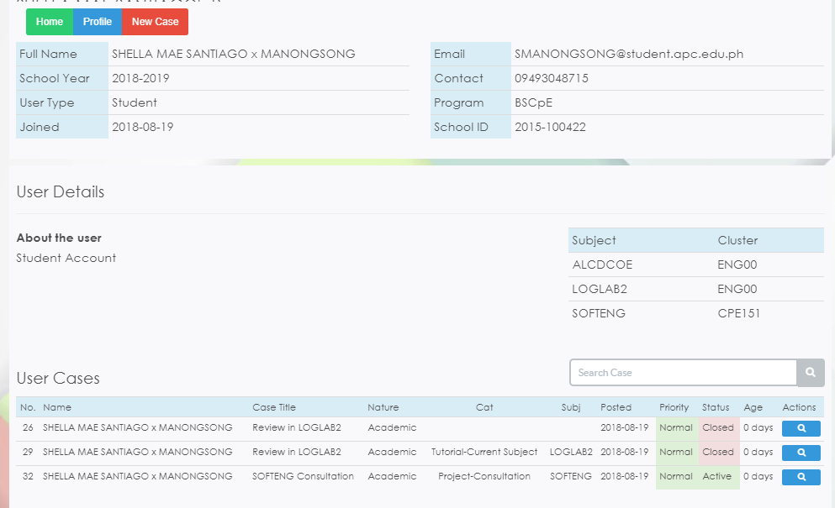
Show all Cases | Demonstration
Problem
Proposed Solution
Objectives
Module Access Level
Functions:
Log in
Account Recovery
Create a Case
Case Management
Add Notes
See all notes
Close Case
Show all Cases
Import to Database
Generate Report
Self Registration
Click this button

Slide 41
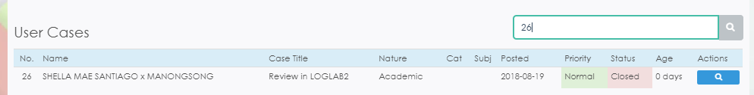
Show all Cases | Demonstration
Problem
Proposed Solution
Objectives
Module Access Level
Functions:
Log in
Account Recovery
Create a Case
Case Management
Add Notes
See all notes
Close Case
Show all Cases
Import to Database
Generate Report
Self Registration

Slide 42
Show all Cases | Evaluation
Problem
Proposed Solution
Objectives
Module Access Level
Functions:
Log in
Account Recovery
Create a Case
Case Management
Add Notes
See all notes
Close Case
Show all Cases
Import to Database
Generate Report
Self Registration
Questions | Yes | No
In homepage, were you able to see the cases you need to answer?
When the “profile” button is clicked, were you able to see the cases (close and open) you created?
Were your able to experience on how to filter the cases you want to see?

Slide 43
Import to Database | Objectives
Problem
Proposed Solution
Objectives
Module Access Level
Functions:
Log in
Account Recovery
Create a Case
Case Management
Add Notes
See all notes
Close Case
Show all Cases
Import to Database
Generate Report
Self Registration
To be able to:
Familiarize the import to database page
Experience on how to import the CSV file

Slide 44
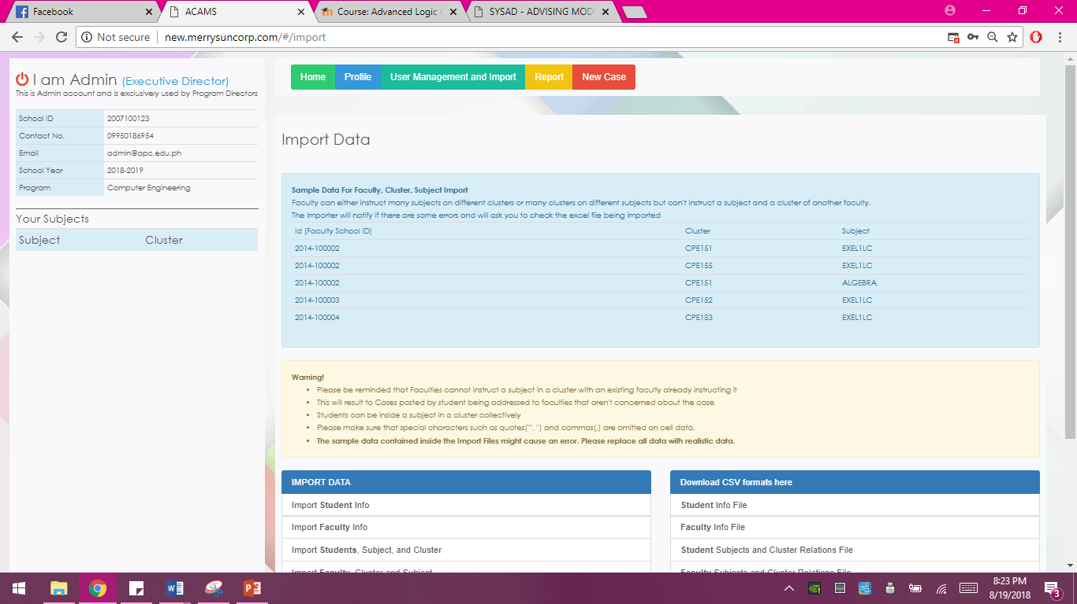
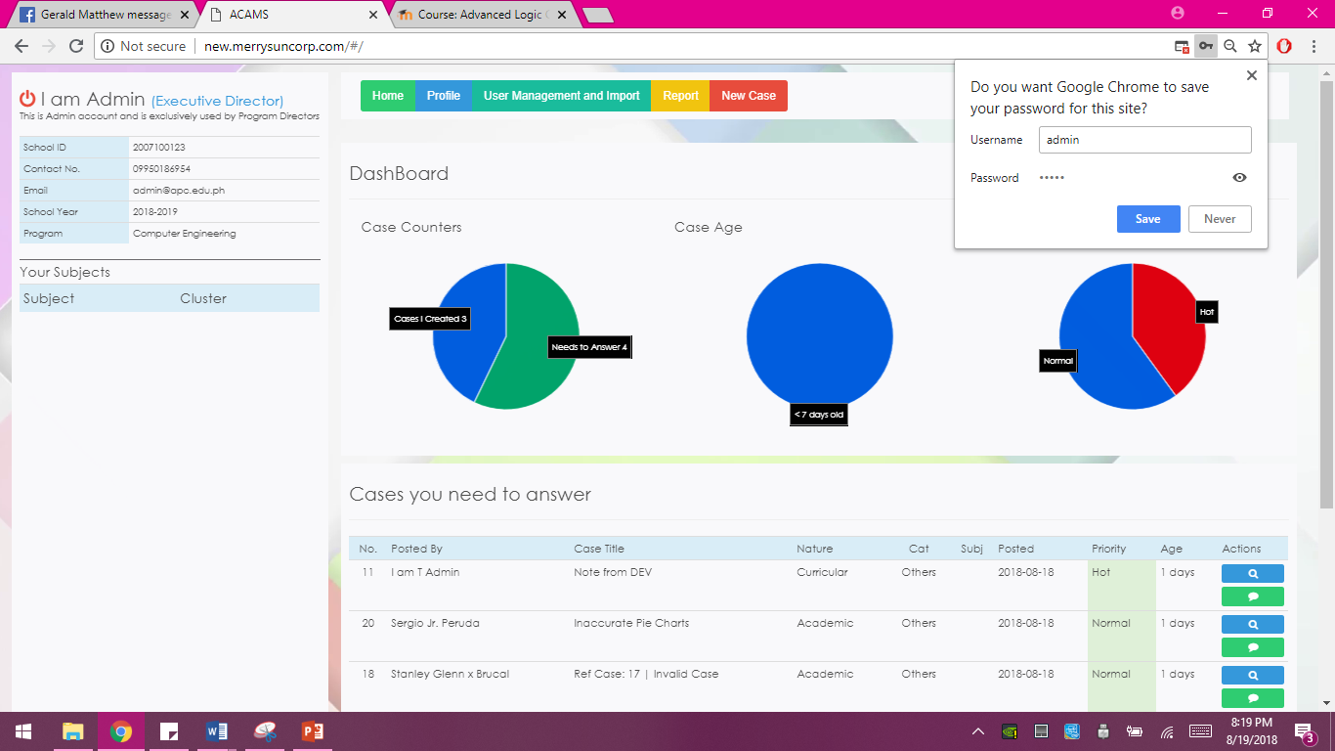
Import to Database | Demonstration
Problem
Proposed Solution
Objectives
Module Access Level
Functions:
Log in
Account Recovery
Create a Case
Case Management
Add Notes
See all notes
Close Case
Show all Cases
Import to Database
Generate Report
Self Registration
Click this button

Slide 45
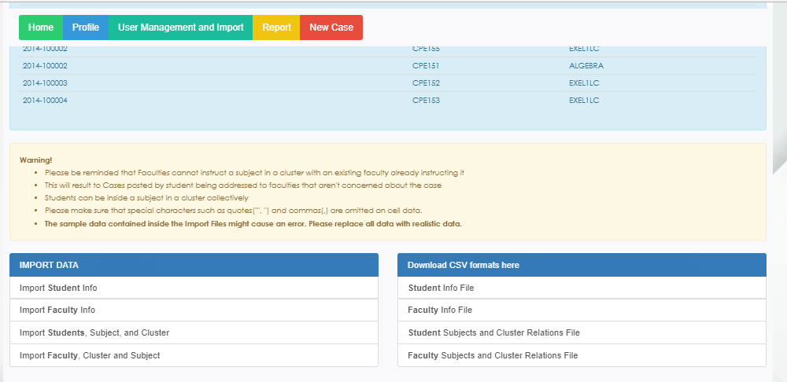
Import to Database | Demonstration
Problem
Proposed Solution
Objectives
Module Access Level
Functions:
Log in
Account Recovery
Create a Case
Case Management
Add Notes
See all notes
Close Case
Show all Cases
Import to Database
Generate Report
Self Registration
Importing data
CSV format

Slide 46
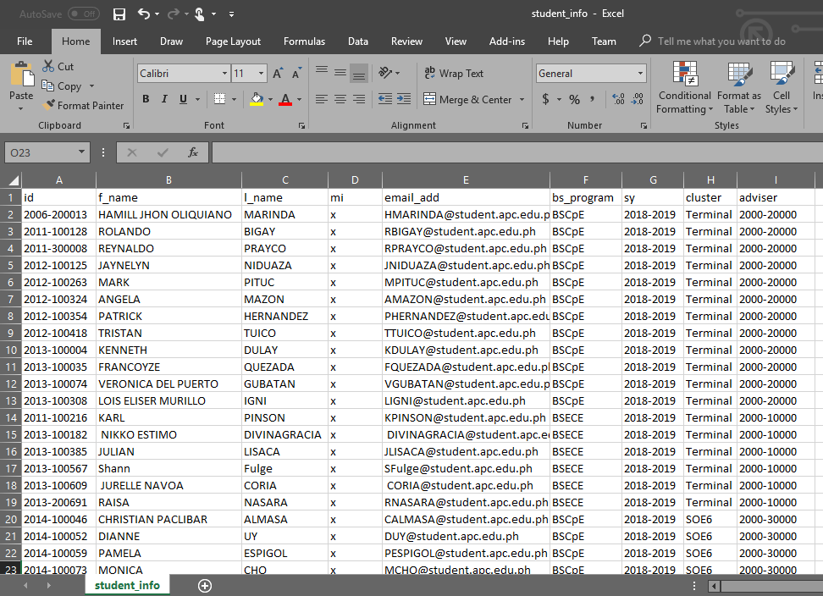
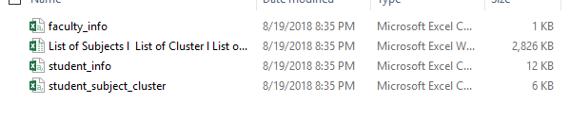
Import to Database | Demonstration
Problem
Proposed Solution
Objectives
Module Access Level
Functions:
Log in
Account Recovery
Create a Case
Case Management
Add Notes
See all notes
Close Case
Show all Cases
Import to Database
Generate Report
Self Registration

Slide 47
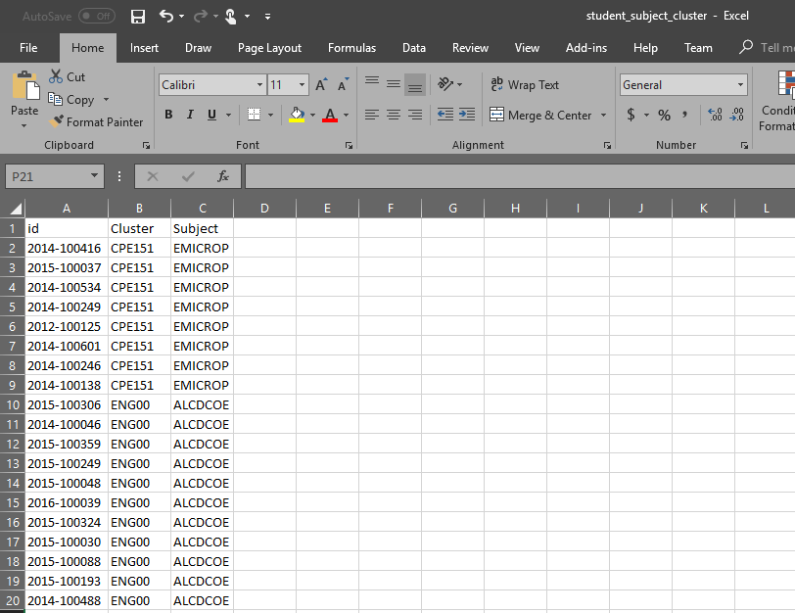
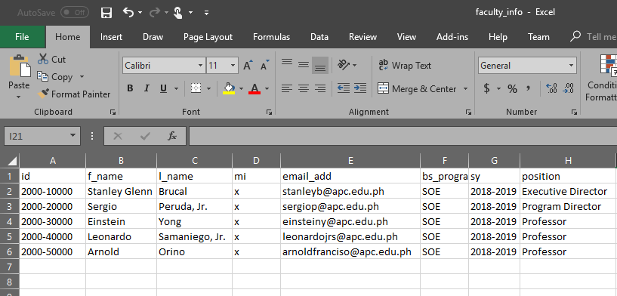
Import to Database | Demonstration
Problem
Proposed Solution
Objectives
Module Access Level
Functions:
Log in
Account Recovery
Create a Case
Case Management
Add Notes
See all notes
Close Case
Show all Cases
Import to Database
Generate Report
Self Registration

Slide 48
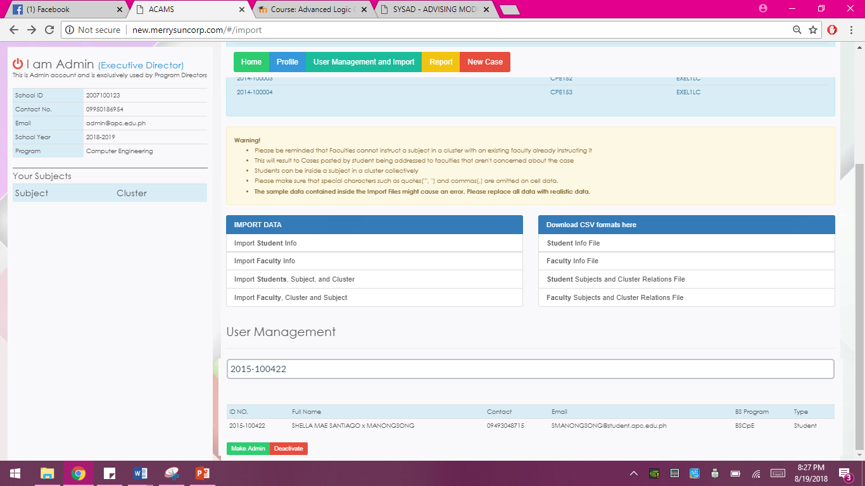
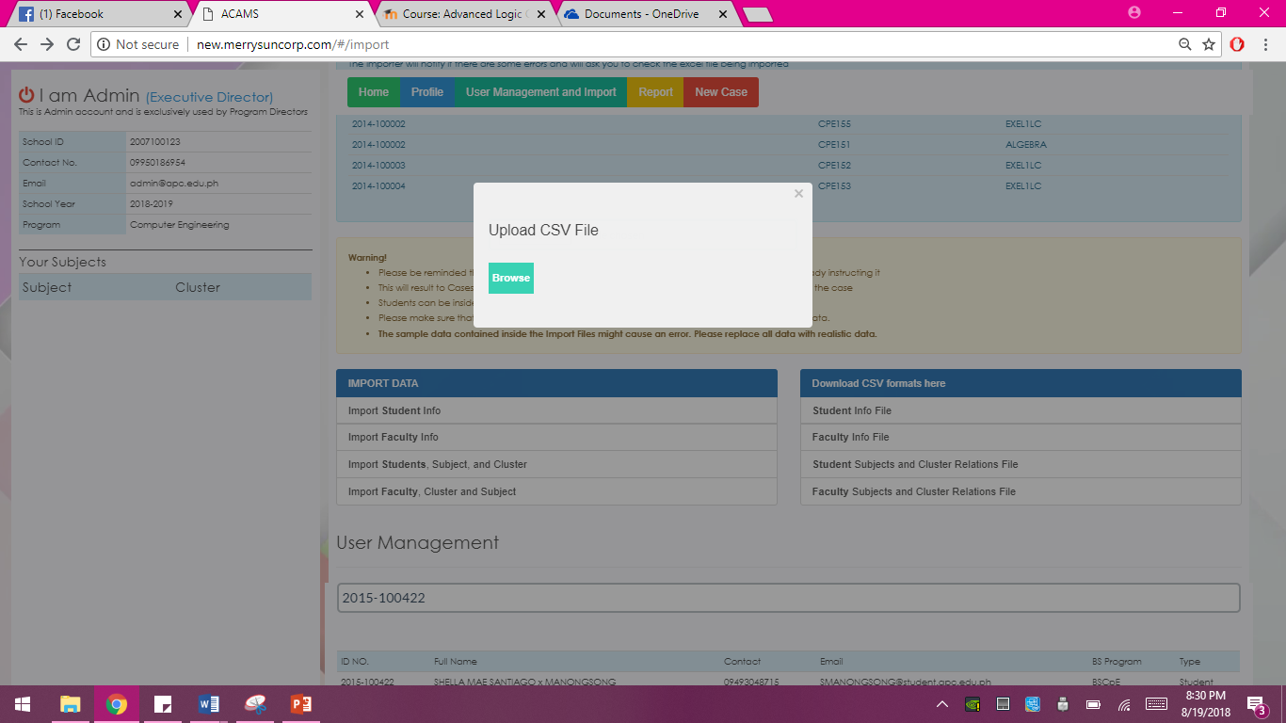
Import to Database | Demonstration
Problem
Proposed Solution
Objectives
Module Access Level
Functions:
Log in
Account Recovery
Create a Case
Case Management
Add Notes
See all notes
Close Case
Show all Cases
Import to Database
Generate Report
Self Registration
Click this button
Click this button

Slide 49
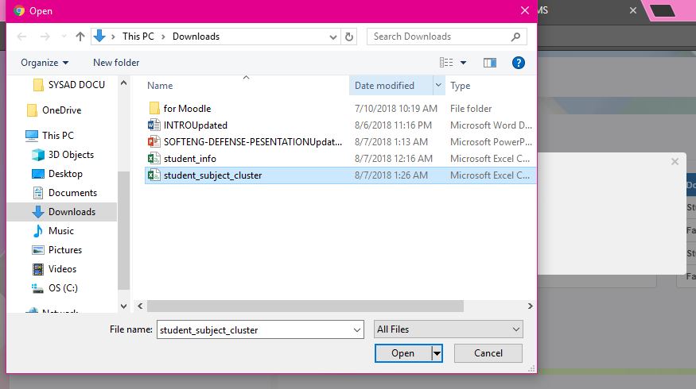
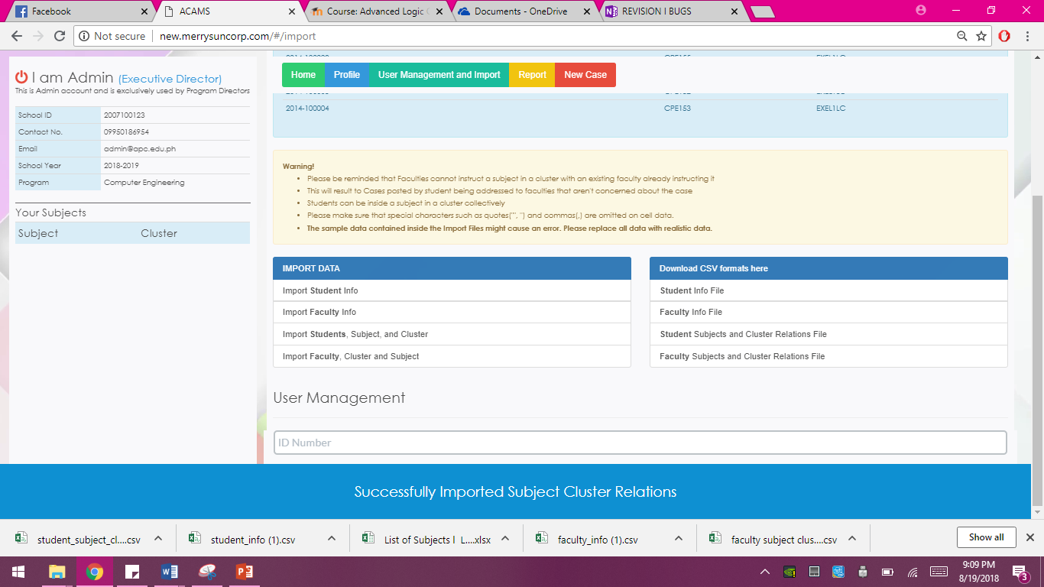
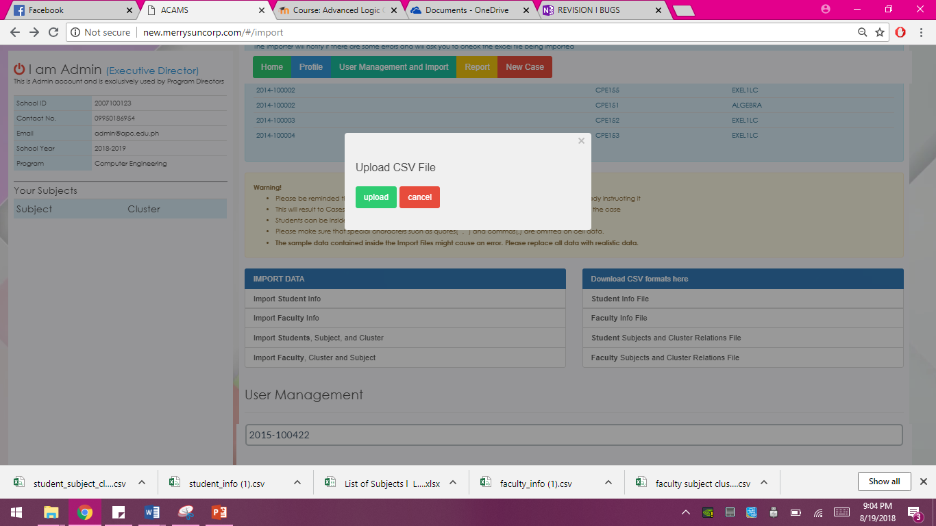
Import to Database | Demonstration
Problem
Proposed Solution
Objectives
Module Access Level
Functions:
Log in
Account Recovery
Create a Case
Case Management
Add Notes
See all notes
Close Case
Show all Cases
Import to Database
Generate Report
Self Registration
Click this button
Choose this file
Click this button

Slide 50
Import to Database | Evaluation
Problem
Proposed Solution
Objectives
Module Access Level
Functions:
Log in
Account Recovery
Create a Case
Case Management
Add Notes
See all notes
Close Case
Show all Cases
Import to Database
Generate Report
Self Registration
Questions | Yes | No
When the “user management and Import” button is clicked, does it proceed you to the importing page?
Were you able to download a CSV file format?
Were you able to import a CSV file to the database?
Are the imported file showing correctly on the database?

Slide 51
Generate Report | Objectives
Problem
Proposed Solution
Objectives
Module Access Level
Functions:
Log in
Account Recovery
Create a Case
Case Management
Add Notes
See all notes
Close Case
Show all Cases
Import to Database
Generate Report
Self Registration
To be able to:
Familiarize with generate report page
Experience generating a report

Slide 52
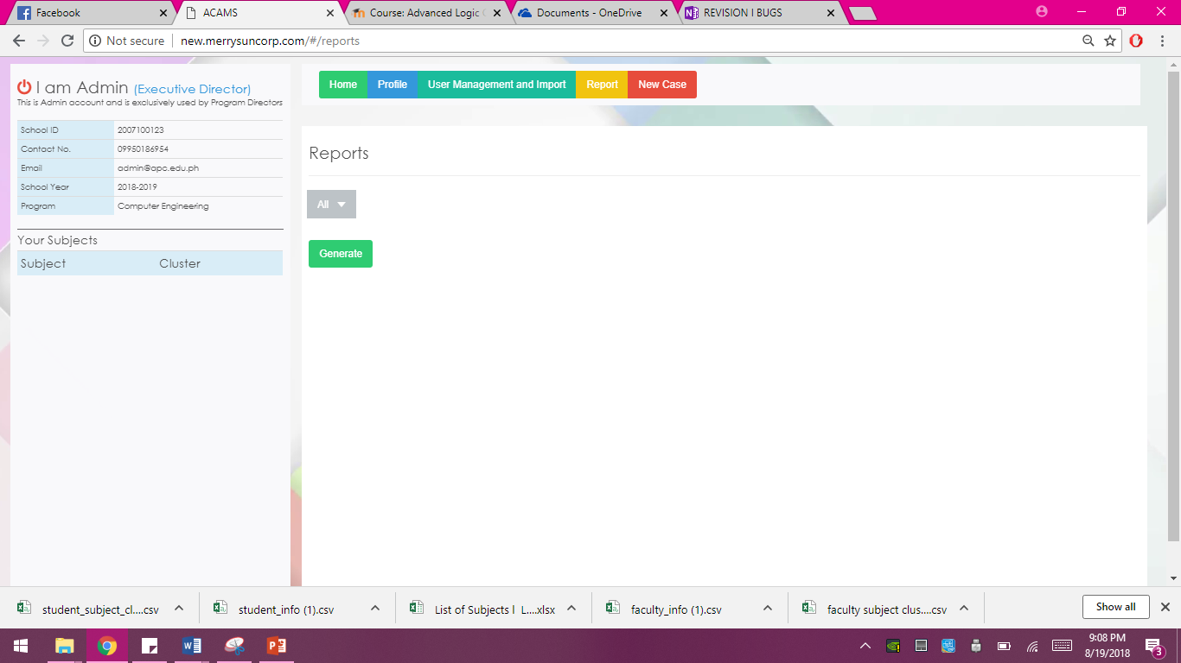
Generate Report | Demonstration
Problem
Proposed Solution
Objectives
Module Access Level
Functions:
Log in
Account Recovery
Create a Case
Case Management
Add Notes
See all notes
Close Case
Show all Cases
Import to Database
Generate Report
Self Registration
Click this button
Click this drop down box

Slide 53
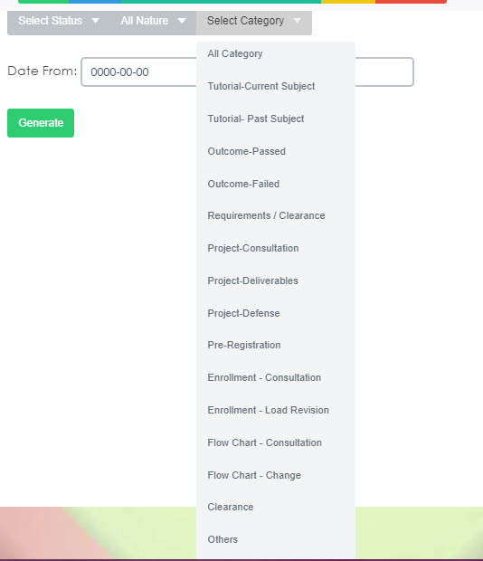
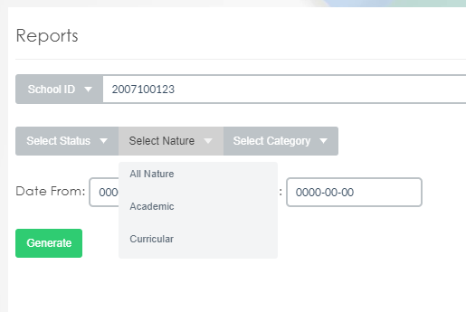


Generate Report | Demonstration
Problem
Proposed Solution
Objectives
Module Access Level
Functions:
Log in
Account Recovery
Create a Case
Case Management
Add Notes
See all notes
Close Case
Show all Cases
Import to Database
Generate Report
Self Registration
Select this
Status of the case/s
Nature of the case/s
Categories of the case/s

Slide 54

Generate Report | Demonstration
Problem
Proposed Solution
Objectives
Module Access Level
Functions:
Log in
Account Recovery
Create a Case
Case Management
Add Notes
See all notes
Close Case
Show all Cases
Import to Database
Generate Report
Self Registration
Enter this button

Slide 55

Generate Report | Demonstration
Problem
Proposed Solution
Objectives
Module Access Level
Functions:
Log in
Account Recovery
Create a Case
Case Management
Add Notes
See all notes
Close Case
Show all Cases
Import to Database
Generate Report
Self Registration
Enter this button

Slide 56



Generate Report | Demonstration
Problem
Proposed Solution
Objectives
Module Access Level
Functions:
Log in
Account Recovery
Create a Case
Case Management
Add Notes
See all notes
Close Case
Show all Cases
Import to Database
Generate Report
Self Registration
Enter new password
Click this button

Slide 57

Generate Report | Demonstration
Problem
Proposed Solution
Objectives
Module Access Level
Functions:
Log in
Account Recovery
Create a Case
Case Management
Add Notes
See all notes
Close Case
Show all Cases
Import to Database
Generate Report
Self Registration
Click this button

Slide 58


Generate Report | Demonstration
Problem
Proposed Solution
Proposed
Objectives
Module Access Level
Functions:
Log in
Account Recovery
Create a Case
Case Management
Add Notes
See all notes
Close Case
Show all Cases
Import to Database
Generate Report
Self Registration
Click this button

Slide 59
Generate Report | Evaluation
Problem
Proposed Solution
Objectives
Module Access Level
Functions:
Log in
Account Recovery
Create a Case
Case Management
Add Notes
See all notes
Close Case
Show all Cases
Import to Database
Generate Report
Self Registration
Questions | Yes | No
When you clicked the “generate report” button, does it proceed to the generate report page?
Are the input fields (text boxes, dropdown boxes) selectable?
Is there a message that notifies user if information inputted is invalid?
Were you able to filter the report you want?
Does the system generate report?
Is the report printable?

Slide 60
Self-registration | Objectives
Problem
Proposed Solution
Objectives
Module Access Level
Functions:
Log in
Account Recovery
Create a Case
Case Management
Add Notes
See all notes
Close Case
Show all Cases
Import to Database
Generate Report
Self Registration
To be able to:
Familiarize with self registration
Experience on how to link your account to the system

Slide 61

Self-registration | Demonstration
Problem
Proposed Solution
Objectives
Module Access Level
Functions:
Log in
Account Recovery
Create a Case
Case Management
Add Notes
See all notes
Close Case
Show all Cases
Import to Database
Generate Report
Self Registration
Click this link

Slide 62

Self-registration | Demonstration
Problem
Proposed Solution
Objectives
Module Access Level
Functions:
Log in
Account Recovery
Create a Case
Case Management
Add Notes
See all notes
Close Case
Show all Cases
Import to Database
Generate Report
Self Registration
ID Number or User Name
Click this

Slide 63

Self-registration | Demonstration
Problem
Proposed Solution
Objectives
Module Access Level
Functions:
Log in
Account Recovery
Create a Case
Case Management
Add Notes
See all notes
Close Case
Show all Cases
Import to Database
Generate Report
Self Registration
User Name
Secret questions and answers
Password
Confirm Password
Contact #

Slide 64


Self-registration | Demonstration
Problem
Proposed Solution
Objectives
Module Access Level
Functions:
Log in
Account Recovery
Create a Case
Case Management
Add Notes
See all notes
Close Case
Show all Cases
Import to Database
Generate Report
Self Registration
Click this button
Click this button

Slide 65
Self-registration | Demonstration
Problem
Proposed Solution
Objectives
Module Access Level
Functions:
Log in
Account Recovery
Create a Case
Case Management
Add Notes
See all notes
Close Case
Show all Cases
Import to Database
Generate Report
Self Registration
Click this button

Slide 66

Self-registration | Demonstration
Problem
Proposed Solution
Objectives
Module Access Level
Functions:
Log in
Account Recovery
Create a Case
Case Management
Add Notes
See all notes
Close Case
Show all Cases
Import to Database
Generate Report
Self Registration
Click this button

Slide 67
Self-registration | Evaluation
Problem
Proposed Solution
Objectives
Module Access Level
Functions:
Log in
Account Recovery
Create a Case
Case Management
Add Notes
See all notes
Close Case
Show all Cases
Import to Database
Generate Report
Self Registration
Questions | Yes | No
When the “link your id” button is clicked, does it redirect you to enter your school id?
Were you able to input your school id?
Is there a message that notifies user if information inputted are incorrect or invalid?
When the “link account” button is clicked, does it redirect you to the link page?
Were you able to enter your log in information?
Were you able to successfully link your account?

Slide 68

Thank You

